Slide 1
Webworx’s DocGen
Name: Revati Sanjay Pawar
Class: M.Sc.(Computer Science) Part II
Roll No.: 42836

Slide 2

Internship Completion Certificate
Date:07/04/2021
To whom it may concern:
Webworx certifies that Ms. Revati Sanjay Pawar successfully completed the internship program from 1 February 2021 to 24th June 2021 at our organization.
During this time, Revati was assigned Software Development and WordPress Development tasks and performed the following assignments: Clutch and care UI, DocGen, HR CRM
• Write well designed, testable, efficient code by using best software development practices
• Create website layout/user interface by using standard HTML/CSS practices
• Integrate data from various back-end services and databases

Slide 3
• Gather and refine specifications and requirements based on technical needs
• Create and maintain software documentation
• Be responsible for maintaining, expanding, and scaling our site
• Stay plugged into emerging technologies/industry trends and apply them into operations and activities
• Cooperate with web designers to match visual design intent
Revati displayed professional traits during her internship period and managed to complete all the assigned tasks as requested. She was hardworking, dedicated and committed. It was a pleasure having her with us in this short period.
Sincerely,
Purva Keskar
Admin & HR Head

Slide 4
Industrial Project Calendar
Month | Week | Particulars | Remark
February-2021 | I | Revised HTML, CSS, and PHP Concepts.
 | II | Introduction to REST API and PDO
 | III | Did Assignments.
 | IV | Revised Jquery, JavaScript Concepts.
 | V | Did Assignments.
March- 2021 | I | Created Admin Panel using Bootstrap 4, HTML, CSS and JavaScript.
 | II | Created Registration Forms with email functionality using Bootstrap 4, HTML, CSS, JavaScript, and Jquery.
 | III | CodeGen Project work. Created forms using Bootstrap 4, HTML, CSS, JavaScript, and Jquery.

Slide 5
Month | Week | Particulars | Remark
 | IV | Created CodGen CURD Operations for fetching records from database using PHP and PDO.
 | V | Designed CodGen Screens.
April -2021 | I | CodeGen Project work.
 | II | Designed Mobile Responsive Screens for Clutch & Care Project
 | III | Designed Screens for Clutch & Care Project
May-2021 | I | DocGen Project Work. Designed Dashboard and other Screens using Bootstrap 4, Jquery, HTML, CSS, JavaScript, and Ajax.
 | II | Created forms and designed database.

Slide 6
Month | Week | Particulars | Remark
 | III | Created Rest API’s for employee details.
 | IV | Created functions and class files for generating pdf using Pdf library.
 | V | Created functions and class files for generating pdf using MPdf library.
June-2021 | I | HR-CRM Project Work . Designed database then model forms using HTML, CSS, Javascript, Ajax, and Jquery for edit records , and other stuff.
 | II | Created Rest API’s for generating PDF documents.
 | III | Created Rest ApI’s for document Contents.
 | IV | Designed forms for Trackacc.uk

Slide 7
Acknowledgement
It has been a great opportunity to gain a lot of experience in real time project, followed by knowledge of actually implementing various ideas in the project and testing them. It helped me to understand and deal with the real time problems that are incurred during the working of a project.
I want to thank all the people who helped me and would like to extend a special gratitude to our HOD, Prof. Shamkant Deshmukh Sir and our project guide, Prof. Trupti Gohad ma'am for their patience and guidance through out the semester.
At last I would like to thank all those people who understood and appreciated the aim of the project and encouraged me to further keep developing such projects.

Slide 8
Contents
Introduction
Problem Definition
Existing System
Need of Computerization
Scope of Proposed System
Objective of Proposed System
Feasibility Study
Requirement gathering and anticipation
Platform (H/W, S/W) with version details
Analysis Specification (Object Oriented Approach)

Slide 9
Contents
Design Specification (Object Oriented Approach)
Data Dictionary
Implementation Strategies
Input/Output Screens
Testing Strategies
Limitations and Drawbacks
Conclusion
Future Enhancements
Reference and Bibliography

Slide 10
Introduction
In every field, it’s important to minimize as much risk as possible.
Documentation is a great tool in protecting against lawsuits and complaints. Documentation help ensure consent and expectations. It helps to tell the narrative for decisions made, and how yourself or the client responded to different situations.
Document Generation is the process of automatically creating documents based on rules. Document Generator is useful when multiple documents need to be generated and each document contains a mixture of: Static content – the parts that remains the same in each document.
“DocGen” is a web application which generates documents and convert them into PDF format. For example Internship offer letters, Appointment letters, etc.

Slide 11
Problem Definition
The whole work of Webworx’s document generation is being done manually. That is, the documents are written or typed manually for each and every time when it is needed. So it is very lengthy and time consuming process to type similar documents each and every time.
Second thing Employee info. / details that is while creating particular document for that particular employee or candidate we need to ask him/her about his/her personal, professional or educational details like full name, address, class, collage name, position, etc.,

Slide 12
Existing System
The whole work of Webworx’s document generation is being done
manually. That is, the documents are written or typed manually for each and every time when it is needed. For example if we want to generate particular document then we need to write its content then we need to work on its style and format.
And while creating particular document for a particular employee we need to ask him/her about his/her personal, professional or educational details like full name, address, class, collage name, position,etc.

Slide 13
Need for Computerization
Each document contains a mixture of:
Static content – the parts that remains the same in each document.
Dynamic content – content that is customized for the audience or recipient of the generated document.
Difficulties arise due to this are,
As each document contains a mixture of: Static content – the parts that remains the same in each document, then there is no point/ need to waste time for typing / writing same content each time for each employee while creating a similar type of document.

Slide 14
Need for Computerization
The document generation work is being done manually, and
employee details are not being maintain, there was one software in which we used to maintain our employee details but now it is outdated. And hence it is very time consuming to ask each employee about their details and then create documents for them.

Slide 15
Scope of the Proposed System
No business model can afford for its employees to waste time on
manual processes, which is why DocGen has native features that help us create customized documents faster, streamline your workflow, and get you back to business.
DocGen is a great tool when multiple documents need to be generated.
It saves much time than the manual work takes for entire document generation process.

Slide 16
Scope of the Proposed System
For example currently we need to write document content then we
need to work on its style and format for each and every document separately. But here in DocGen we can generate any document on just one click.
This project will help to maintain the employee details which will be useful in future for retrieving the data for further document generation as per the requirements.

Slide 17
Objectives of the Proposed System
DocGen automatically generates documents in PDF format.
It saves much time than the manual work takes for entire document generation process.
With the help of DocGen we can generate any document on just one click.
DocGen maintains information of employees so it becomes easy to access particular employee details while generating any type of document.
We can also download employee details into excel file format with the help of DocGen.

Slide 18
Requirement Gathering and Anticipation
The whole work of Webworx’s document generation is being done
manually. That is, the documents are written or typed manually for each and every time when it is needed. So it is very lengthy and time consuming process to type similar documents each and every time.
DocGen is a great tool when multiple documents need to be generated. It saves much time than the manual work takes for entire document generation process.

Slide 19
Platform (H/W, S/W) with version details
Software Specification
Operating System: Windows OS.
Application Platform: Apache web server, MySQL database , PHP Version 7.4.0. , and PhpMyadmin for managing MySQL databases.
Front End and Back End - HTML, CSS, JavaScript, Ajax, Jquery, PHP,
and MySQL.
Hardware specification
Intel i5 processor.
200 MB of free hard drive space.
128 MB of RAM.

Slide 20
Analysis Specification (Object Oriented Approach)
Questionnaires and Interviews :-
1.How the process is carried out currently ?
Answer :- Currently the entire process is being done manually, i.e. we are creating documents by manually typing.
2.What kind of documents are you creating ?
Answer :- We need to create multiple documents for our clients and employees as well. Like Internship offer letters, Appointment letters, etc.

Slide 21
3.What difficulties are you facing while creating these documents?
Answer :- Firstly it’s very difficult and time consuming to create
documents for each and every time as our complete work is being done
manually. We need to do the same thing again and again even if we do copy pasting of static content.
4.What about dynamic content ?
Answer :- For dynamic content we asked candidate for their personal, educational, professional details and then we create document as per the requirement. We had one software in which we used to maintain employee details but it is outdated now.
5.Is there any specific format which you follow while creating documents.?
Answer :- Format, content and style changes as per the document. And most of our documents are in PDF format

Slide 22
6.How many documents do you create?
Answer :- As per our requirements.
7.And after creating document for a particular candidate are you maintaining any records of it? i.e. this document is created for this candidate and what was the document, etc.
Answer :- No.
8.What are your expectations? What do you want your web application should contain?.
Answer :- Web application must create our documents automatically and in PDF format, which will help us a lot.

Slide 23
Observation :-
The whole system for the document creation of Webworx is being done
manually, though we have one software but it is outdated, and hence employee details are not being maintain anywhere for documentation purpose.

Slide 24
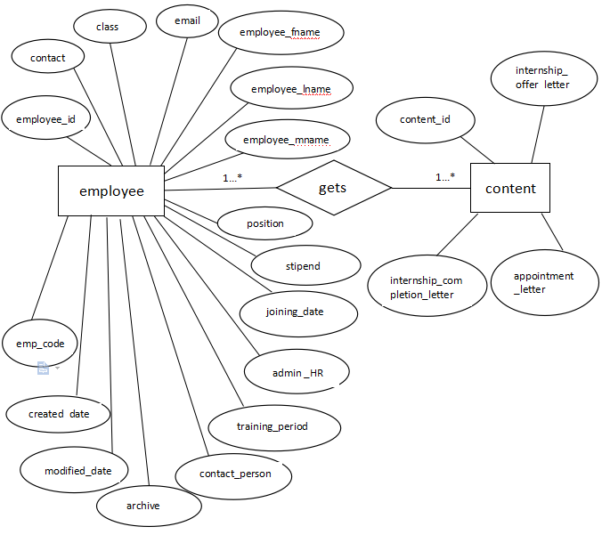
Design Specification (Object Oriented Approach)
ERD

Slide 25
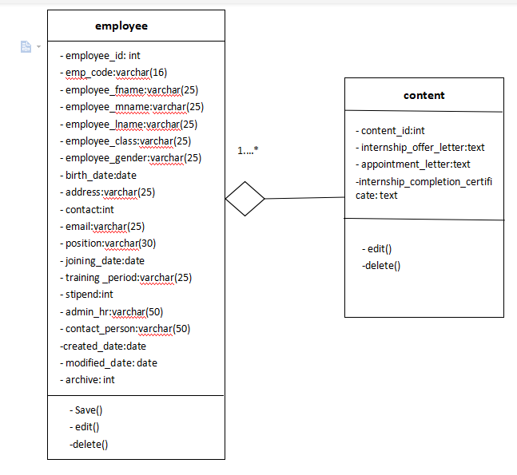
Class Diagram:

Slide 26
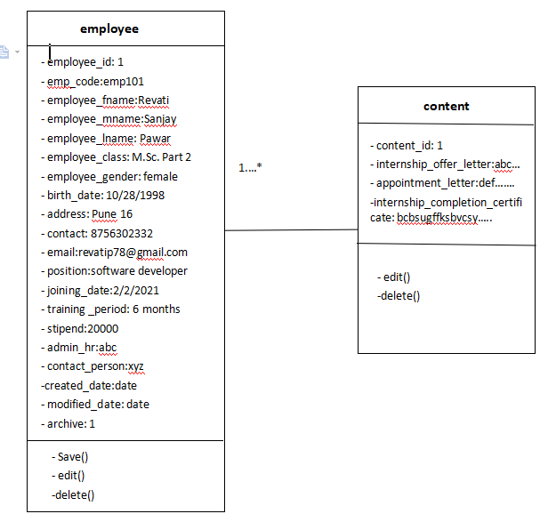
Object Diagram:

Slide 27
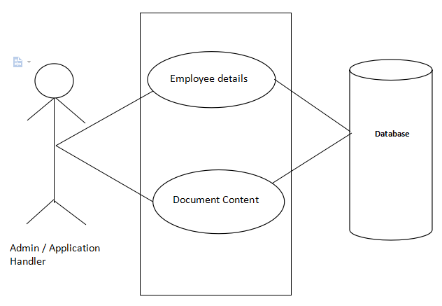
Use case Diagram:

Slide 28
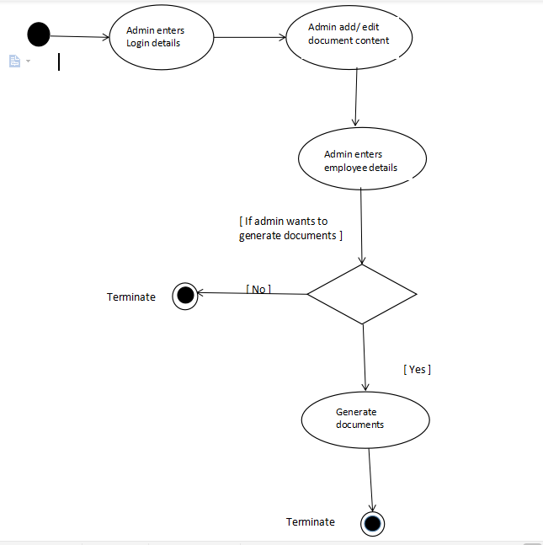
Activity Diagram:

Slide 29
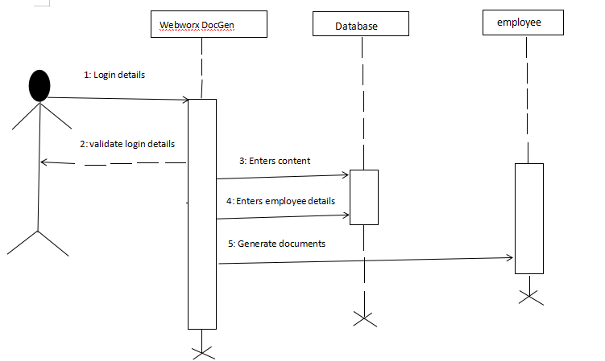
Sequence Diagram:

Slide 30
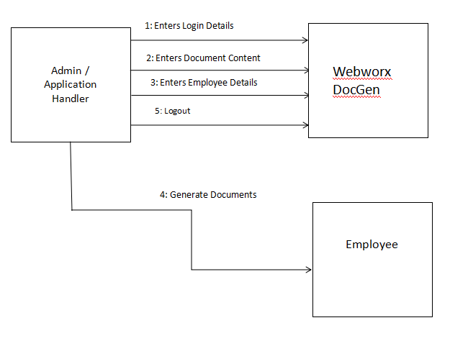
Collaboration Diagram:

Slide 31
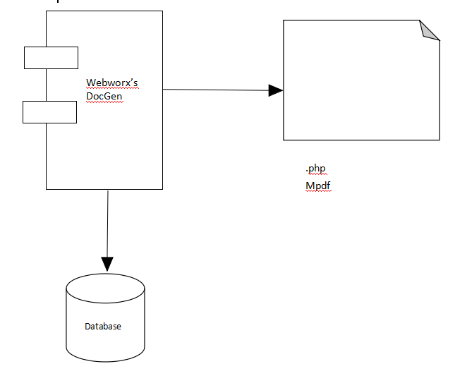
Component Diagram:

Slide 32
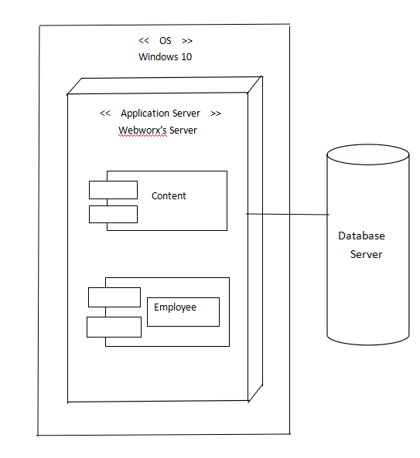
Deployment Diagram:

Slide 33
Data Dictionary
employee
Field | Type | Null | Key | Default
employee_id | Varchar(25) | No | Primary | Null
employee_code | Varchar(25) | No |  | Null
documentation_date | Date | No |  | Null
employee_fname | Varchar(30) | No |  | Null
employee_mname | Varchar(30) | No |  | Null
employee_lname | Varchar(30) | No |  | Null
employee_birth_date | Date | No |  | Null
employee_contact | Int | No |  | Null
employee_email | Varchar(30) | No |  | Null
employee_address | text | No |  | Null
employee_class | Varchar(40) | No |  | Null
employee_joining_date | Date | No |  | Null
employee_position | Varchar(40) | No |  | Null
Training_period | Varchar(30) | No |  | Null
stipend | Int | No |  | Null
contact_person_name | Varchar(40) | No |  | Null
admin_hr_name | Varchar(40) | No |  | Null

Slide 34
Implementation Strategies
Package :-
mPDF :-
mPDF is a PHP library which generates PDF files from UTF-8 encoded HTML.
It is based on FPDF and HTML2FPDF with a number of enhancements.
CSS stylesheets
Word spacing and character spacing for justification
Page headers & footers
Columns

Slide 35
Tables - nested tables, rotated, or auto sized to fit on a page
Table of contents
Index
Watermarks (with customizable text angle)
Images in JPG, GIF, PNG, SVG, BMP or WMF format
Password protection

Slide 36
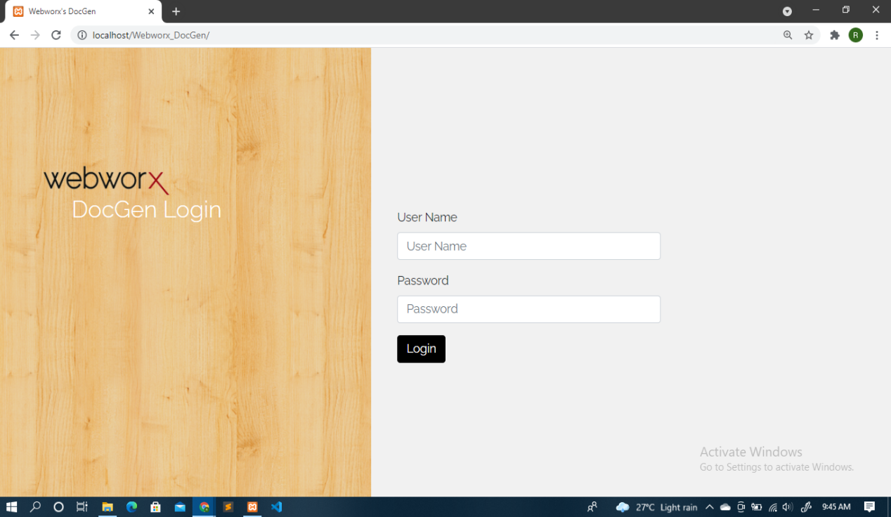
Input Output Screens

Slide 37
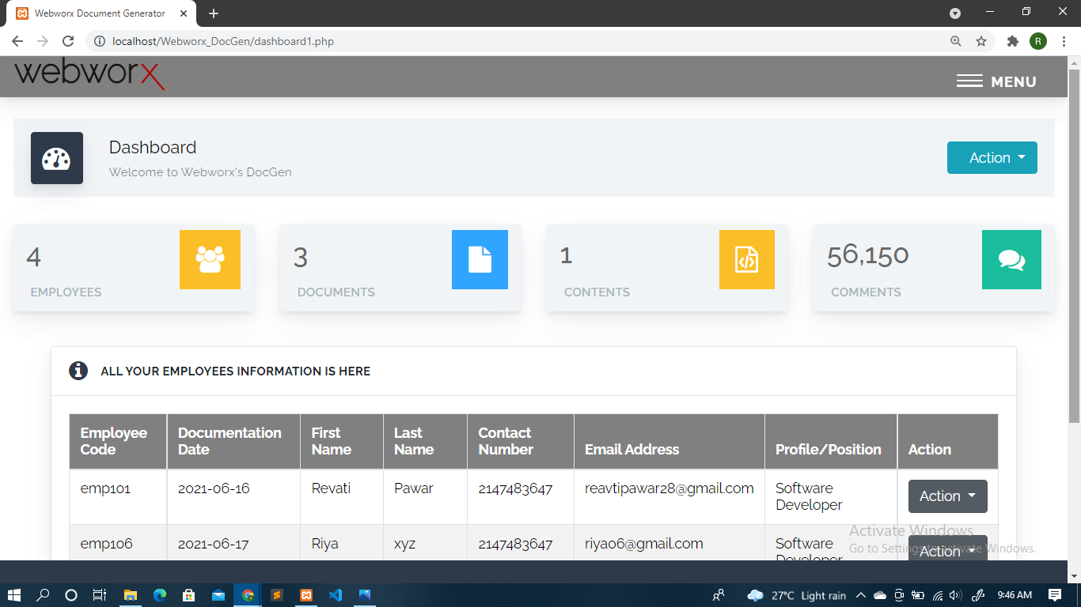

Slide 38
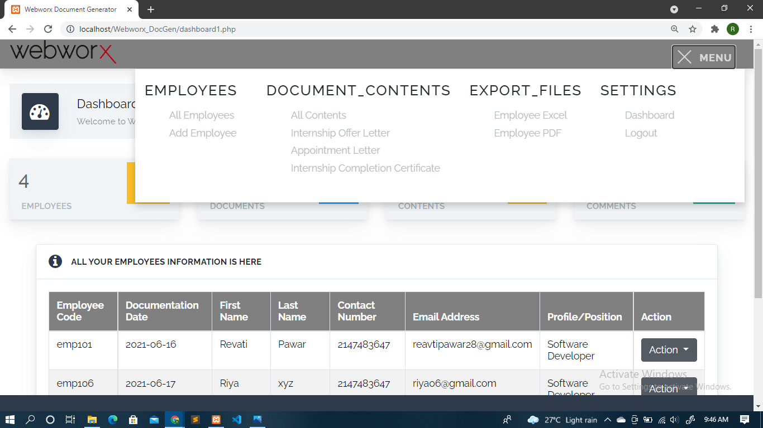

Slide 39
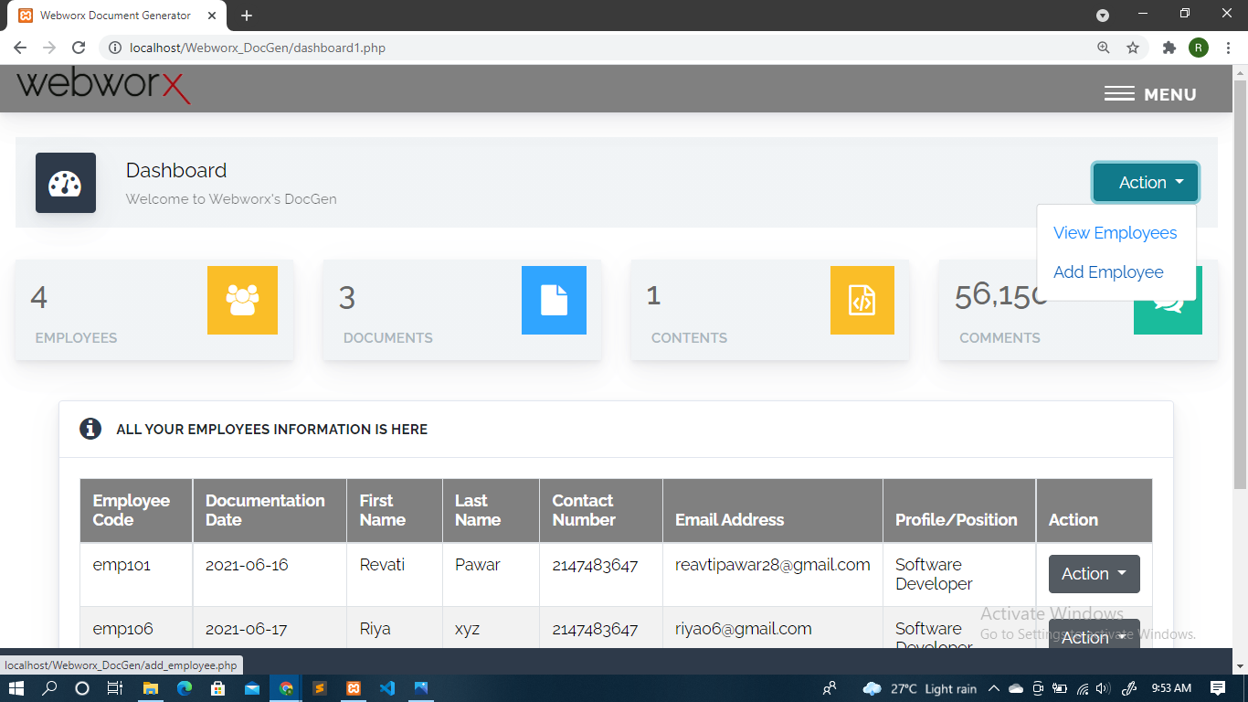

Slide 40
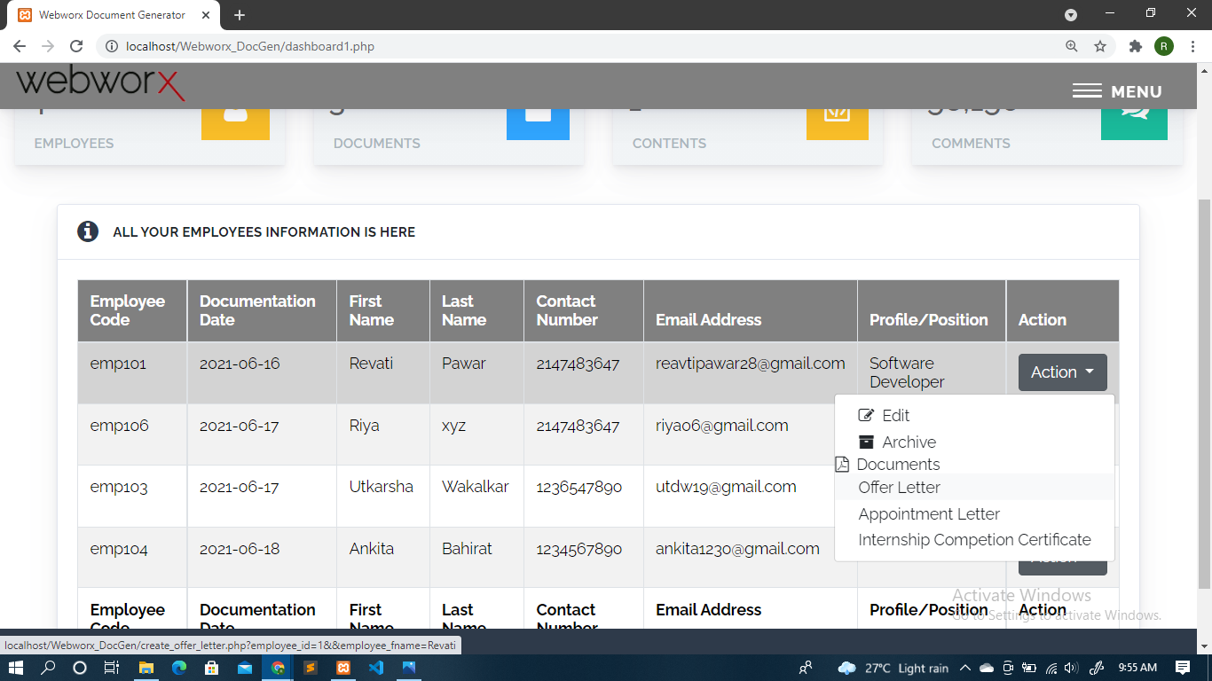

Slide 41
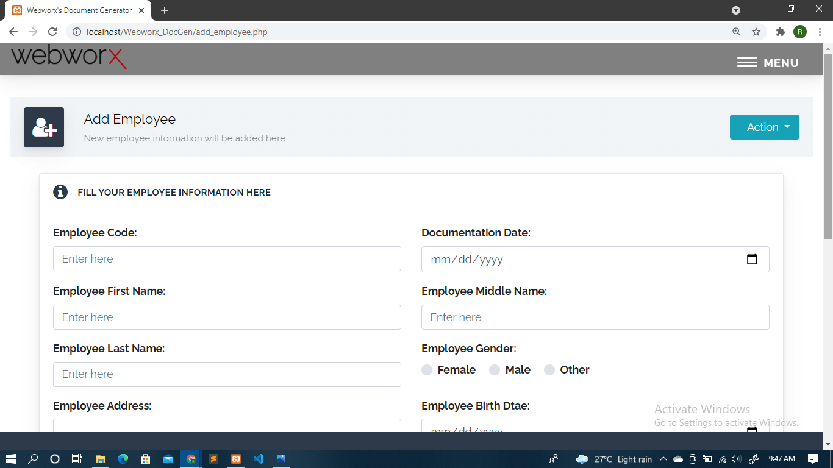

Slide 42
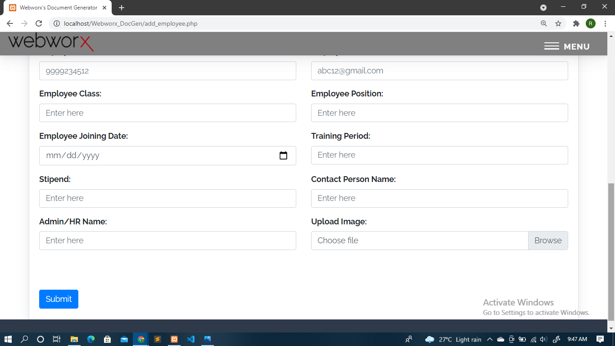

Slide 43
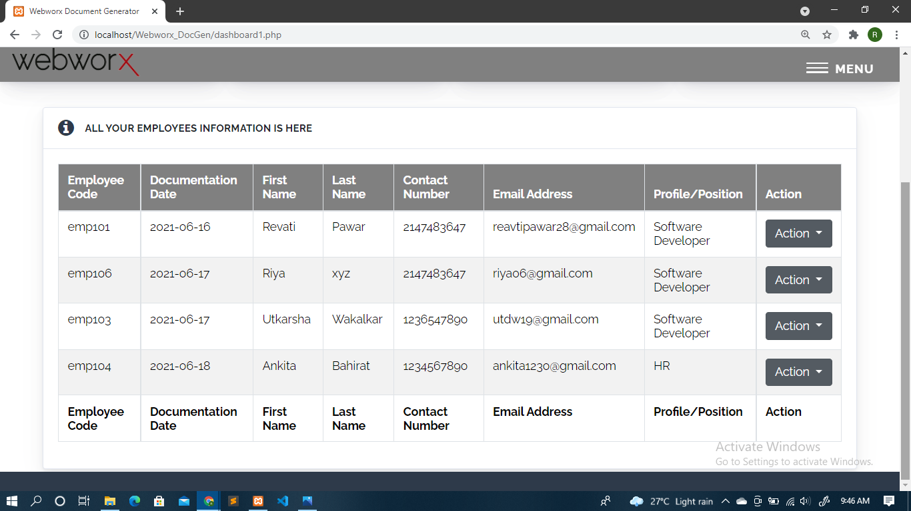

Slide 44
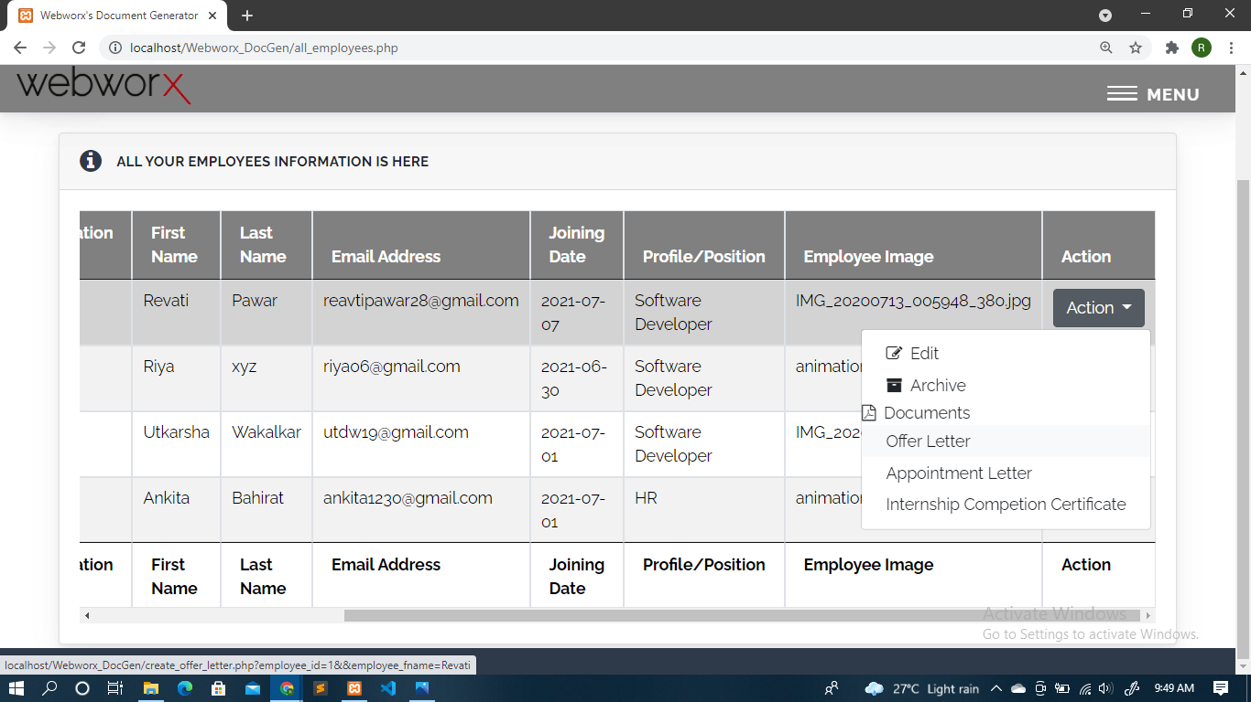

Slide 45
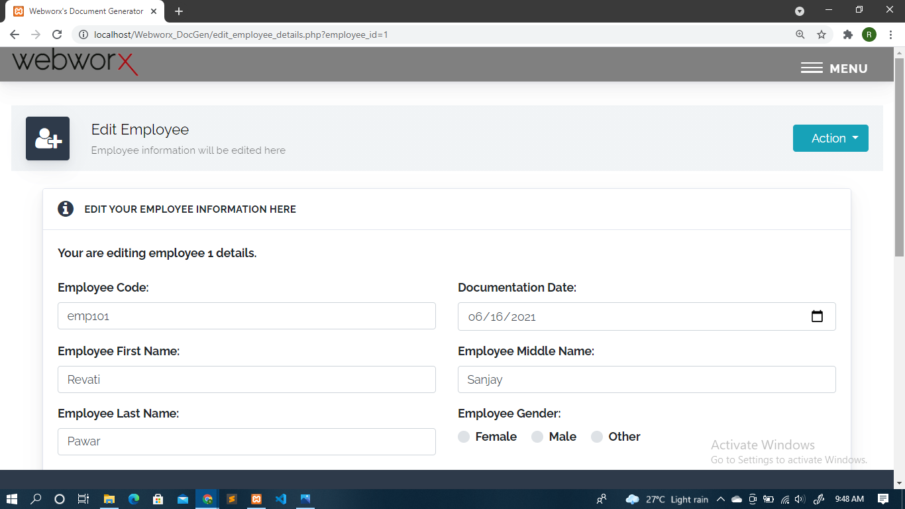

Slide 46
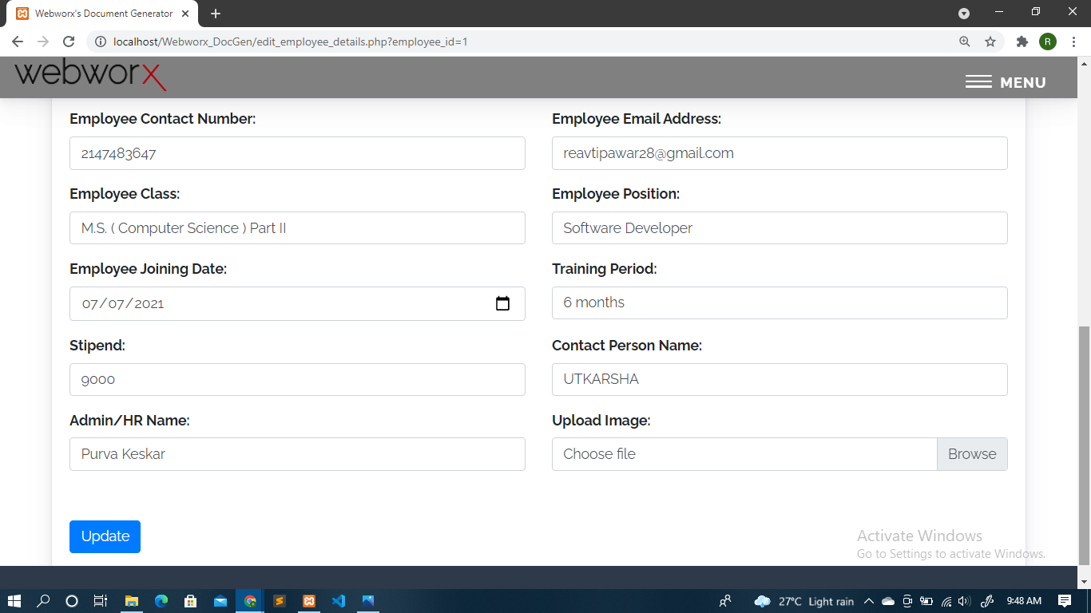

Slide 47
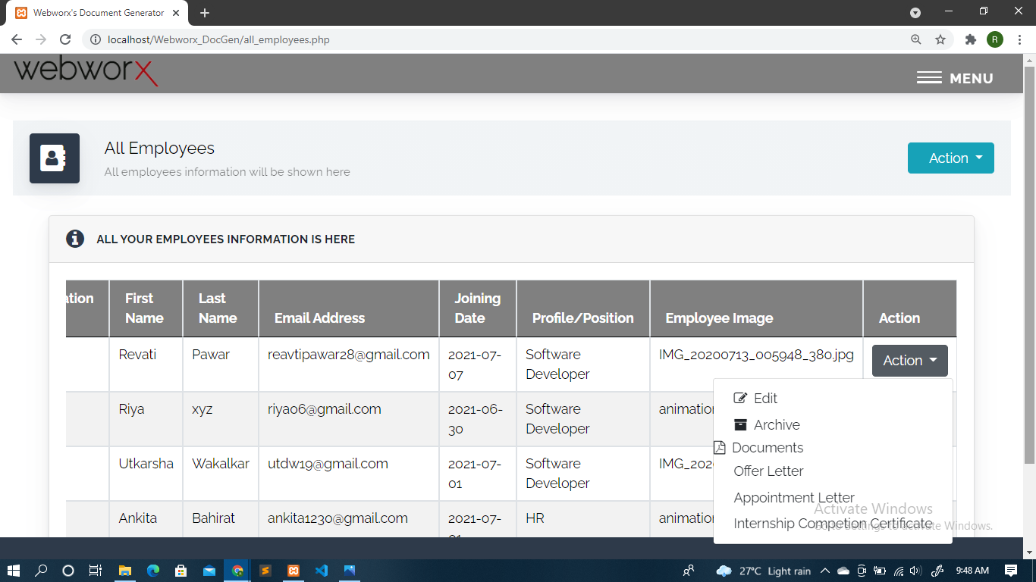

Slide 48
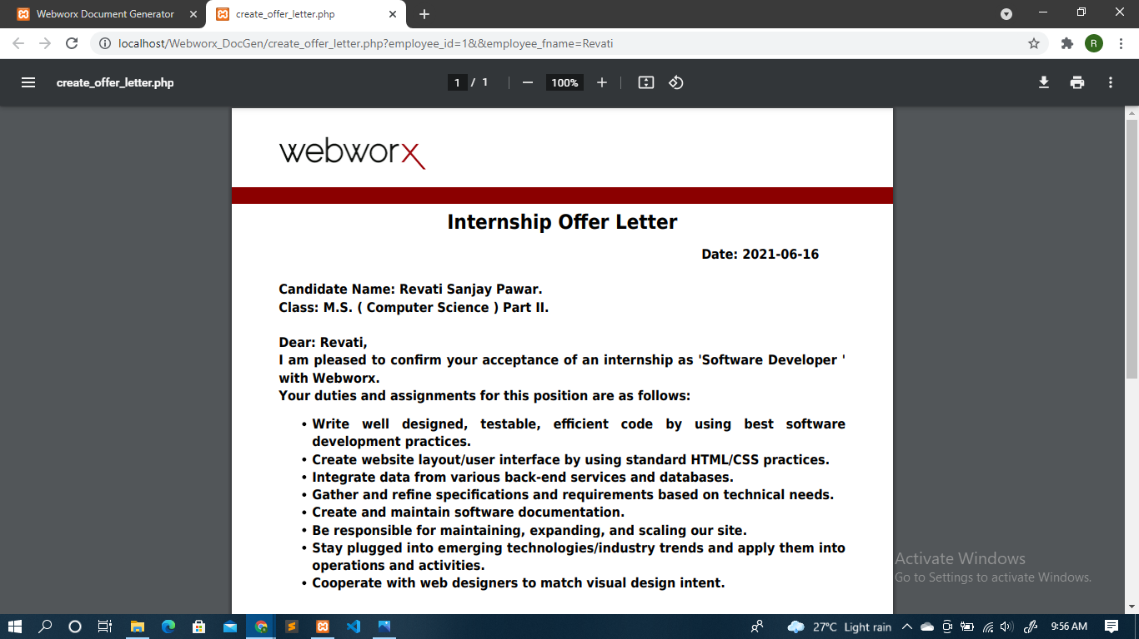

Slide 49
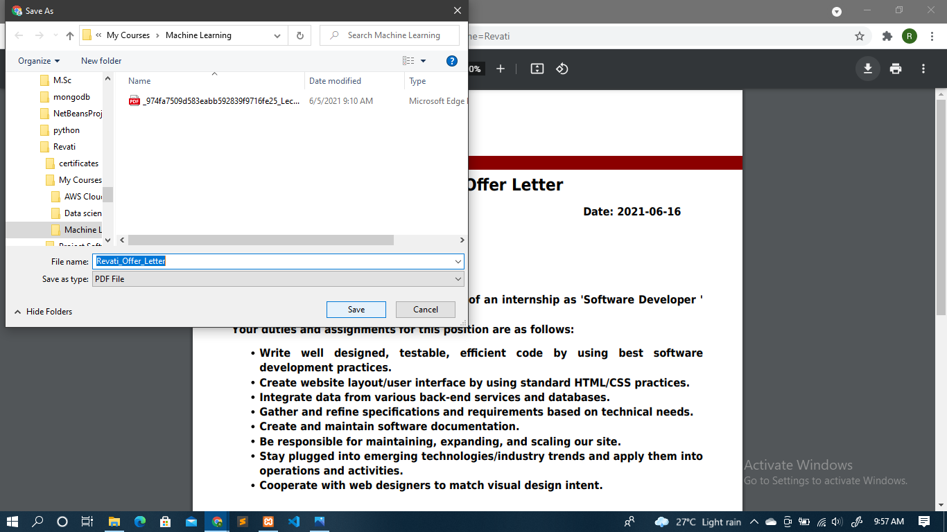

Slide 51
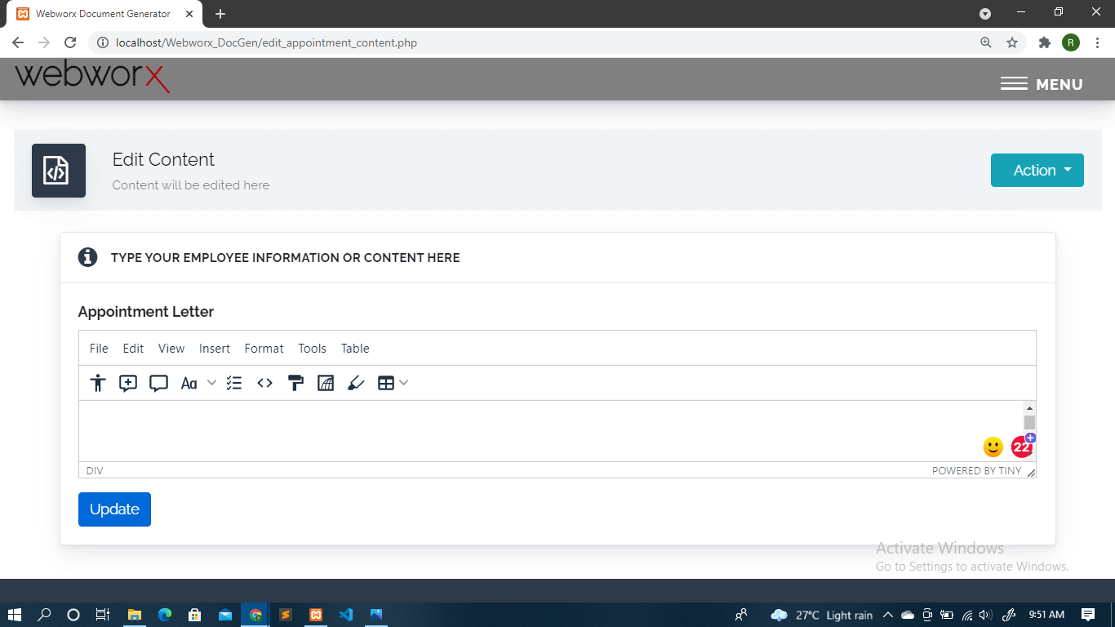

Slide 52
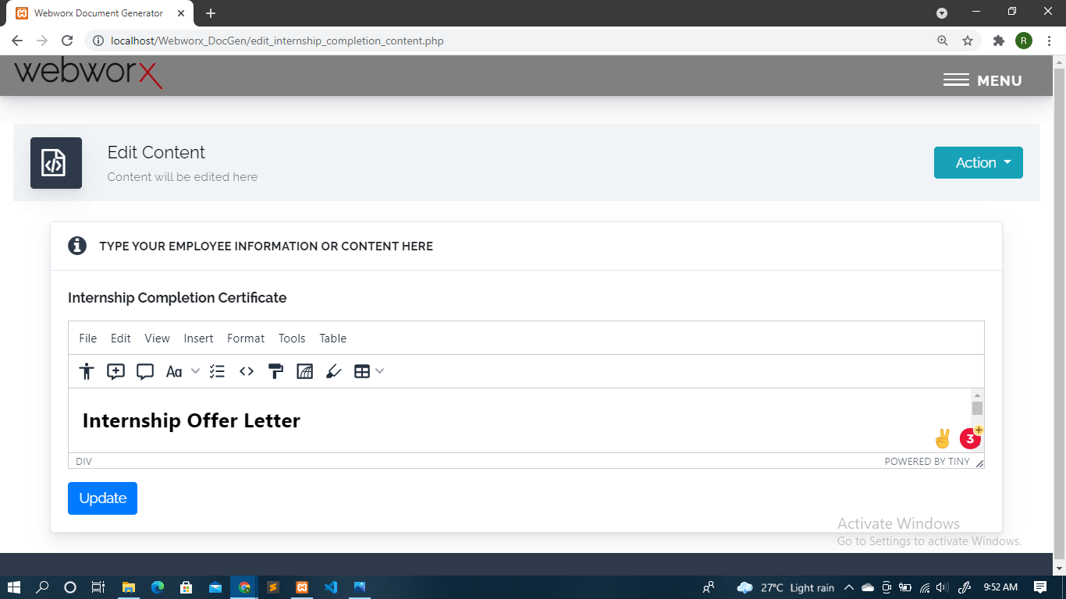

Slide 53
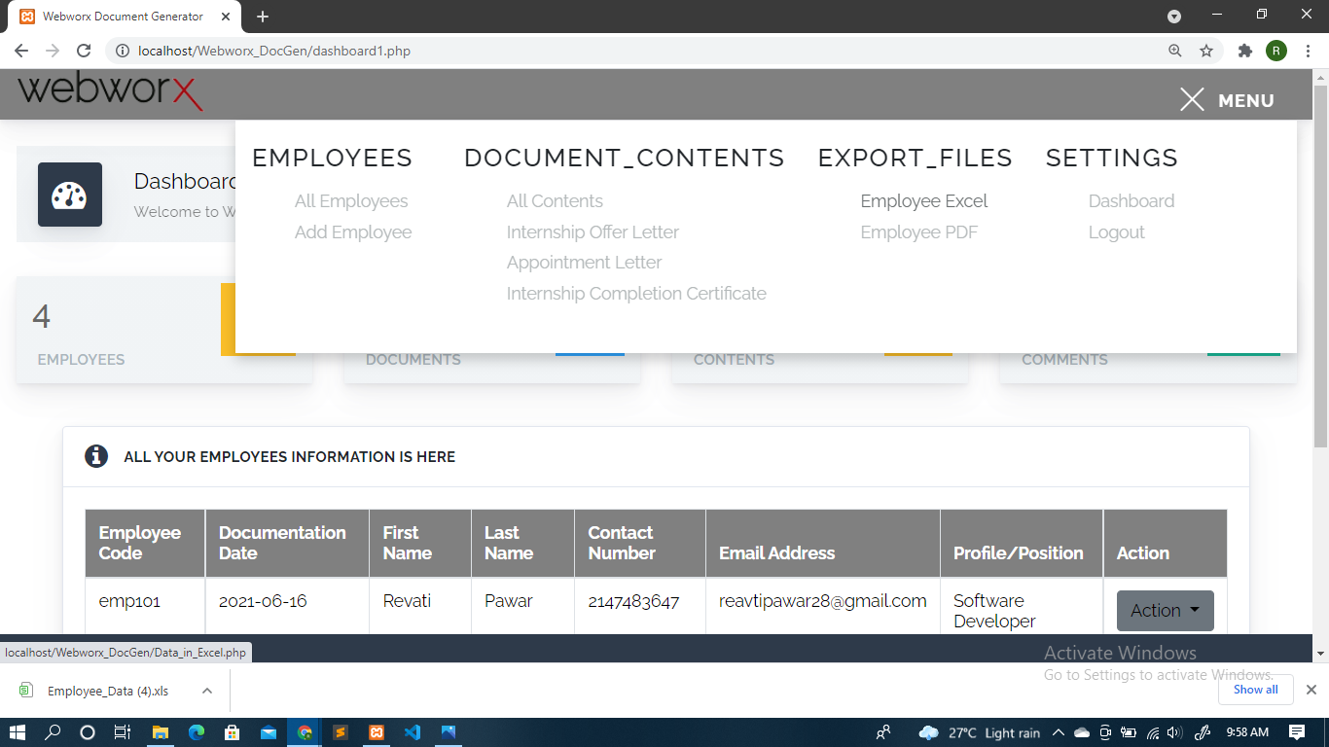

Slide 54
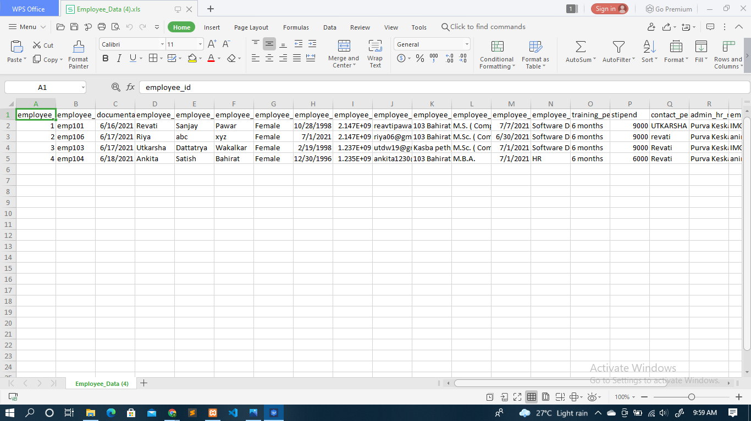

Slide 55
Testing Strategies
Employee
Test Case | Test case name | Prerequisites (pattern) | Input | Expected result | Actual result | Status
TC01 | EmployeeCode | Contains alphanumeric value. Maximum size should be 16.. | eg. Abc12231232323235,As12@,etc | Should not be accepted maximum length must be 16 | Max length of id should be 16 and it should be alphanumeric | Fail
 | EmployeeCode | Contains alphanumeric value. Maximum size should be 16.. | eg. Abc1223 | Should be accepted as it satisfies the pattern | Accepted | Pass
 | Employee first name | [a-zA-Z] {1,32} | eg. 123abc, abc12, abc_12, etc | Should not be accepted as it contains integer or special symbols | Employee first name should contain letters only | Fail
 | Employee first name | [a-zA-Z] {1,32} | eg. Revati etc. | Should be accepted as it satisfies the pattern. | Accepted. | Pass

Slide 56
 | Employee middle name | [a-zA-Z] {1,32} | eg. 123abc, abc12, abc_12, etc | Should not be accepted as it contains integer or special symbols | Employee middle name should contain letters only | Fail
 | Employee middle name | [a-zA-Z] {1,32} | eg. sanjay etc. | Should be accepted as it satisfies the pattern. | Accepted. | Pass
 | Employee last name | [a-zA-Z] {1,32} | eg. 123abc, abc12, abc_12, etc | Should not be accepted as it contains integer or special symbols | Employee last name should contain letters only | Fail
 | Employee last name | [a-zA-Z] {1,32} | eg. pawar etc. | Should be accepted as it satisfies the pattern. | Accepted. | Pass

Slide 57
 | Employee Contact Number | ^ [6-9] {1} [1-9] {9} | eg. 4123678889, 12345, 34990033, etc. | Should not beaccepted as it doesn’t begin with [6-9] & doesn’t contains 10 digits | Please enter valid contact. | Fail
 | Employee Contact Number | ^ [6-9] {1} [1-9] {9} | eg,8796416049, etc. | Should be accepted as it matches the pattern. | Accepted. | Pass
 | Employee Email | Should contain one ‘@’ and at least one ‘.’ | eg. 123abc.com lol@123, etc. | Should not be accepted as it doesn’t follow the pattern. | Enter valid email address. | Fail
 | EmployeeEmail | Should contain one ‘@’ & at least one ‘.’ | eg.revati@gmail.com, etc | Should be accepted. | Accepted. | Pass
 | Employee Address | [a-zA-Z] {1,32} | eg. 123abc, abc12, abc_12#@, etc. | Should not be accepted as it contains integer or special symbols | should contain letters only. | Fail
 | EmployeeAddress | a-zA-Z] {1,32} | If one of either is selected | Should be accepted as it satisfies the pattern | Accepted. | Pass

Slide 58
Employee Class | /[a-zA-Z0-9.]/ | eg. 123abc, abc12, abc_12, etc | Should not be accepted as it doesn’t follow the pattern. | Employee Class should contain letters only | Fail
Employee Class | /[a-zA-Z0-9.]/ | eg. M.Sc. Part 1,etc. | Should be accepted as it satisfies the pattern. | Accepted. | Pass
Employee position | [a-zA-Z] {1,32} | eg. 123abc, abc12, abc_12, etc | Should not be accepted as it contains integer or special symbols | Employee position should contain letters only | Fail
Employee position | [a-zA-Z] {1,32} | eg. Revati etc. | Should be accepted as it satisfies the pattern. | Accepted. | Pass
Training period | [1-9]|1[0-2] | eg. 122,0000a,etc. | Should not be accepted as it doesn’t satisfies the pattern. | Please enter valid Training period. | Fail
Training period | [1-9]|1[0-2] | eg. 1,2,10, etc | Should be accepted as it satisfies the pattern. | Accepted. | Pass

Slide 59
 | Stipend | ^[0-9]*$ | eg. A1000,%43er.,4000/,etc. | Should not be accepted as it doesn’t begin with [0-9] and doesn’t contains alphabets and other characters. | Please enter valid stipend. | Fail
 | Stipend | ^[0-9]*$ | eg. 10000,etc. | Should be accepted as it satisfies the pattern. | Accepted. | Pass
 | Contact person name | [a-zA-Z] {1,32} | eg. 123abc, abc12, abc_12, etc | Should not be accepted as it contains integer or special symbols | Contact person name should contain letters only | Fail
 | Contact person name | [a-zA-Z] {1,32} | eg. RevatiSanjay Pawar etc. | Should be accepted as it satisfies the pattern. | Accepted. | Pass
 | Admin / HR name | [a-zA-Z] {1,32} | eg. 123abc, abc12, abc_12, etc | Should not be accepted as it contains integer or special symbols | Admin / HR name should contain letters only | Fail

Slide 60
 | Admin / HR name | [a-zA-Z] {1,32} | eg. RevatiSanjay Pawar etc. | Should be accepted as it satisfies the pattern. | Accepted. | Pass

Slide 61
Limitations and Drawbacks
Limitations are important to work the web application better.
In our web application the limitations are as follows:
I have developed this web application for “Webworx India private limited” only.
Only admin can handle this application. Employees and Clients don’t have any access to it.
Admin can only maintain details of employee, and documents content.
Admin can generate documents only for the employee whose records are stored in the database.
We can only generate documents whos content is already set into the database.

Slide 62
Conclusion
This project helps in understanding the creation of an interactive web
application and the technologies used to implement it. The building of the project has given me a precise knowledge about how it is used to develop, how it connects to the database to access the data and how the data is modified to provide a user with a good web application.

Slide 63
Future Enhancements
Now I am generating documents and downloading it on our system,
so I am planning to send generated documents directly to that particular employee on their email as it will become more easy for the admin to send documents to the employee.

Slide 64
Reference and Bibliography
www.google.com
www.w3school.com
www.tutorialspoit.com
MPdf Manual and tutorials.
Bootstrap tutorials
PHP tutorials.
PDO tutorials.

Slide 65
Thank You!

